Slide 1

GP Leadership Fellowship:12-month Review
Dr Divya Kuttappan( GP Leadership Fellow –Lincolnshire Training Hub)

Slide 2
My Roles …
GP Partner –Parkside Medical Centre ,Boston (June 2023)
PCN –Health Inequalities Lead and Deputy Clinical Director
GP Leadership Fellow
GP Trainer
GP Mentor for ACP Trainee
Lincolnshire LMC Committee member

Slide 3
Why –Leadership Roles?
Passion for population health management.
Like to challenge myself.
I would like to be involved in decisions that positively influence the health and wellbeing of the local population .

Slide 4
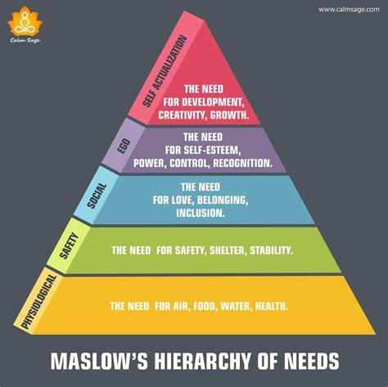
Self –Assessment
Creativity, Development and Growth
Self-esteem and recognition

Slide 5

Why Leadership Fellowship?
Imposter Syndrome ??
New Partner
PCN Role

Slide 6
SWOT Analysis
Strength
Clinical Knowledge
Communication skills
Familiarity with local population
Passion and motivation for public health
Opportunities
GP partner and PCN roles
Networking opportunities with other service providers
Guidance from Training Hub and Mentors
Weakness
Knowledge gap in Leadership skills
Lack of experience in Leadership roles
Threats
Time-management
Lack of Projects
Lack of engagement from other agencies and individuals
Multiple roles

Slide 7

GP Leader – Expectations
Envisioning the future
Setting Strategic Direction
Analysing Data
Considering options for deploying resources
Developing ourselves and others
Maintaining our health and well being
Leadership: 2. Leadership - understanding yourself | RCGP Learning

Slide 8
Projects
Practice Based
PCN Based
Population Health
Personal Development

Slide 9
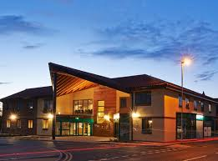
Practice Based projects
Lipid Management
Implementing Group consultation
Setting up :
Care –Navigation template
E workflow
QOF and Result clinic

Slide 10

Lipid Management
Lipid Lead for Parkside Medical Centre

Slide 11

Lipid Project
Aim and Objective :
Improve lipid Management and facilitate implementation of new lipid pathway in Surgery and Local area

Slide 12
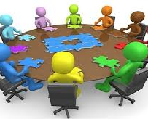
GP lipid tool kit – feedback
Lipid Nurses Visit to Parkside Medical Centre
Lipid pathway promotion by organising Lipid nurses talk at Boston GP training programme .
Lipid Protocol for surgery
Set up of E-workflow

Slide 13
SMART action plan
S – Formulate Lipid protocol and create e-workflow
M-Lipid protocol with continuous auditing of Lipid QOF targets
A- Workflow implemented and being used by entire practice
R- Lipid pathway presented and circulated to clinicians
T- All achieved within 6 months

Slide 14
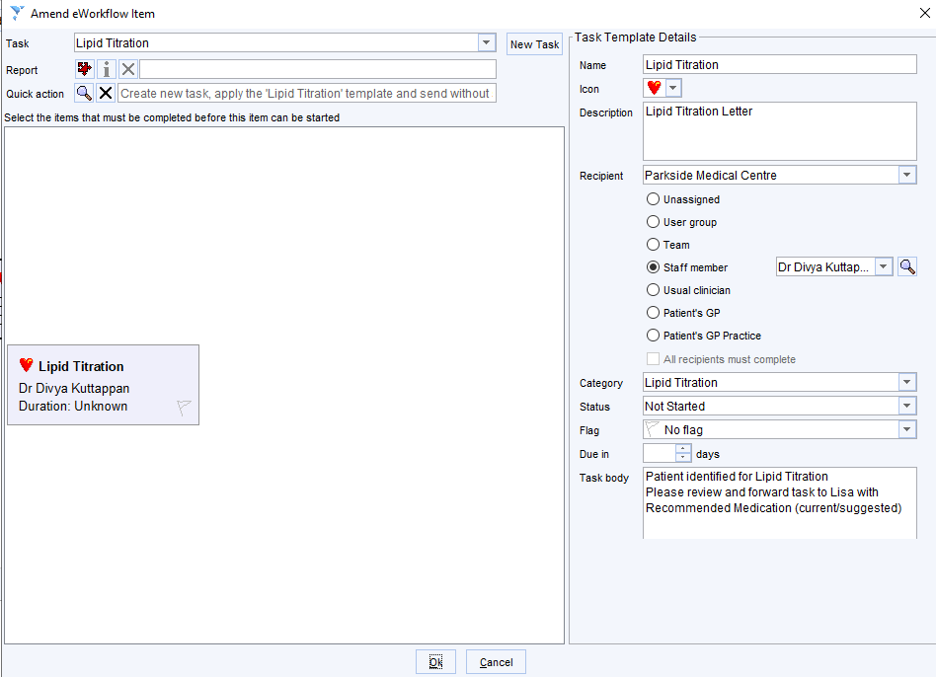

Slide 16

Cholesterol Lowering Therapy
Jan – March 2023
1024
Jan to March 2024
1209

Slide 17
GP Leader – Expectations
Envisioning the future
Setting Strategic Direction
Analysing Data
Considering options for deploying resources
Developing ourselves and Others
Maintaining our health and well being
Leadership: 2. Leadership - understanding yourself | RCGP Learning

Slide 18
Care Navigation Template
Setting up template for care -navigators/reception staff

Slide 19

Low Morale
Under pressure
Receiving end of complaints /frustrations
Inconsistency
Variability
Inappropriate appointments

Slide 20
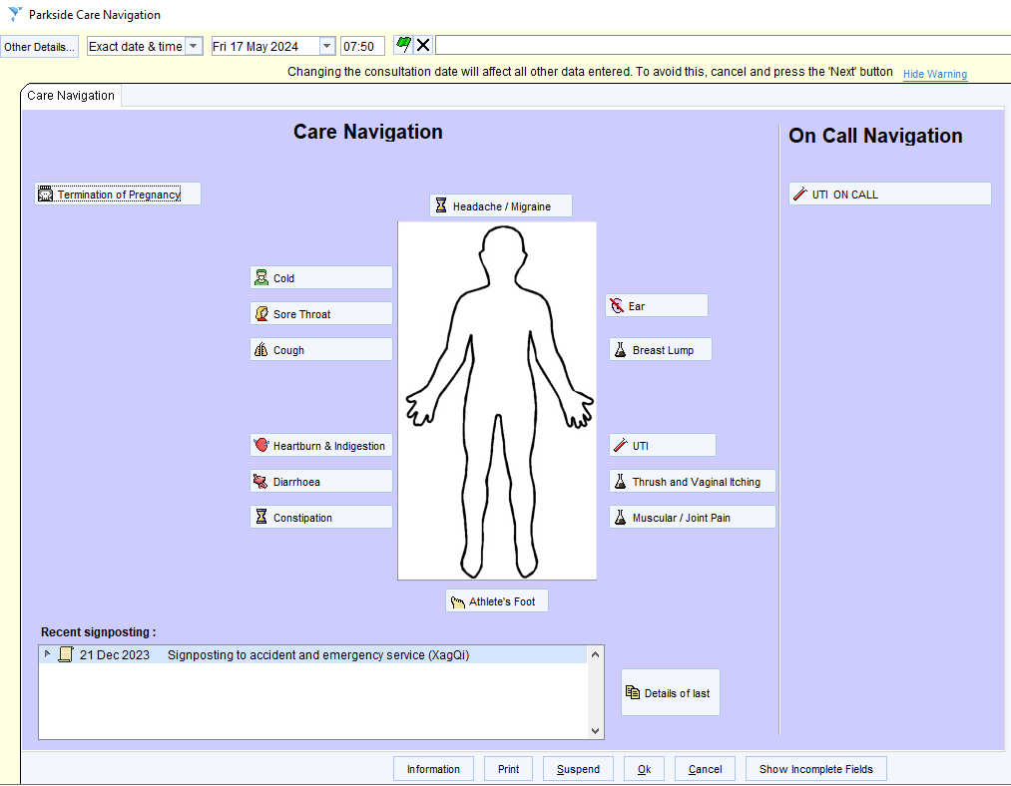
Care –Navigation Template
Discussion with Reception staff
Listened to their concerns
List of common conditions
Worked on template with help of PM
Rolled out one by one
Amended and adapted as per feedback

Slide 21
Developing care navigation template –Skills Used
Set up template for care-navigation
Looking at available resources
Discussion and motivation about new change
Trouble shooting
Conflict resolution

Slide 22

Feedback from Reception Staff
“Great to quote off template with confidence “
“Fantastic to be able to triage “
“Triage is helpful but would like more issues on the template “
“Triage is helpful “
“Good to be able to tell patients that we have used triage template built by doctors and give accurate clinical advice.”
“Also gives patients more confidence in us, Don’t have to put on hold and ask for advice”.
“Does not cover skin issues “.
“No mental health”.
“Needs more issues to be added please”.
“Could we have skin issues”.

Slide 23
Outcome
More streamlined process
Uniformity in triaging
Less pressure on reception staff
Better sign-posting
Greater acceptance from patients
Boosted confidence and staff morale

Slide 24
GP Leader – Expectations
Envisioning the future
Setting Strategic Direction
Analysing Data
Considering options for deploying resources
Developing ourselves and Others
Maintaining our health and well being
Leadership: 2. Leadership - understanding yourself | RCGP Learning

Slide 25

Implementing Group Consultations in the practice

Slide 26
Implementing Group consultation in the practice.
Trial clinic done with High Q risk patients in October 2023
Research about Group consultation
Planning
Delegation
Inclusivity and encouraging other staff members
Measure success :Feedback forms

Slide 27
Trial Clinic in October –High Q risk Patients
Good feedback but not well attended
Timing - During Morning clinic times
Method of Communication – letter invite to selected patients

Slide 28
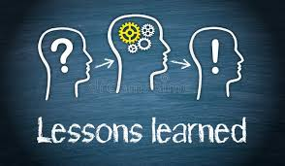
Changes Implemented
Lunch Time appointment
Batch messaging via AccuRx /Letter
Reminder text messages
Self-booking link to patients

Slide 29
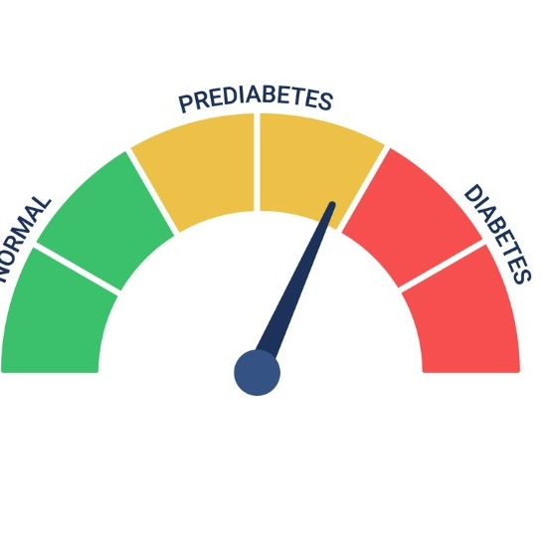
Pre-Diabetes Group Consultation 22/05/24
Diabetes Prevention Week
Well Attended
Q and A session and Group Discussion
Team Involvement –GP Registrars and GPA

Slide 30

Excellent !!

Slide 31
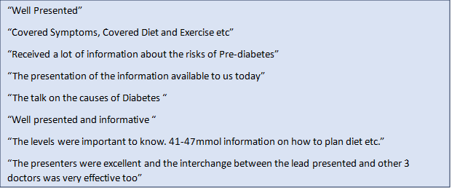
Excellent Feedback

Slide 32
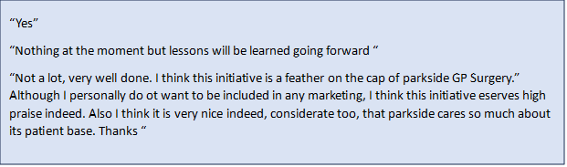

Slide 33
Introducing and promoting the use of e –workflow
Raised Q –Risk
Raised Cholesterol
Lipids target
CKD –stage 3

Slide 34
Setting up of Results and QOF clinic
5 minutes telephone clinic for discussing results
Lots of resistance
Negotiation and trouble shooting
Clinics are still running with close monitoring and open to review

Slide 35

PCN Based Projects

Slide 36
Health Inequalities Strategy
Data Analysis
Identify cohort of patients to target
Developed action plan

Slide 37
PCN Projects : Addressing Health Inequalities
Hypertension Out-reach clinic as part of addressing health inequalities
Meeting with ICB personnel
Novel ideas like approaching work- place and other venues
Running successfully

Slide 38
Health Inequalities Strategy
AF – all practices to manually palpate pulse or use device at all health checks
3. Early Cancer diagnosis – under cancer workstream
4. COPD – PCN wide audit of COPD registers and those that have had a yearly review/Pneumococcal, flu and Covid vaccinations and those that have not to determine current position. To inform plan
5. SMI – PCN to cross reference registers with LPT
Events/projects – women’s health hubs and men’s health event. Integrated Neighbourhood Teams

Slide 39
Health Inequalities
IIF – LD health check, plan and ethnicity
Core 20% - obtain PHM data use this data to target specific cohorts of patients
Plus – Our ethnic groups and Eastern European
5
Maternity
Hypertension – outreach clinics. Practice to send group ACCURX to anyone over 40 years (not had BP in last 5 years and newly registered) asking them to provide a BP.

Slide 40
Skills set used and knowledge gained
Understanding data and population health
Setting priorities
Negotiating
Liaising with other service provider and the third sector

Slide 41
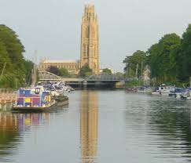
Projects aimed at promoting health and well-being of local population.

Slide 42

Initiating patient engagement events in the surgery aimed at local population

Slide 43

Women’s Health Day 23/03/2024
Planning
Research
Liaising with other service providers
Setting agenda
Organising speakers
Measuring outcome

Slide 44

Topics Covered
Breast Awareness and myth busting
Menopause and HRT
Yoga and Balance Strengthening

Slide 45
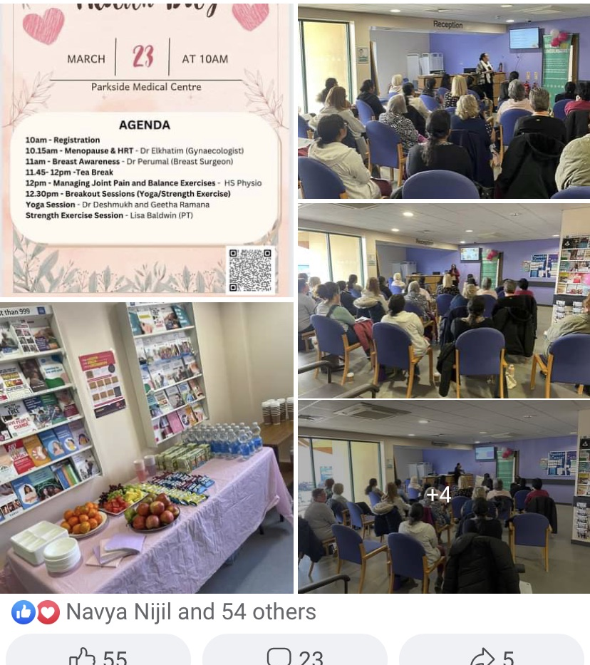
Women’s Health Day -23/03/24

Slide 46
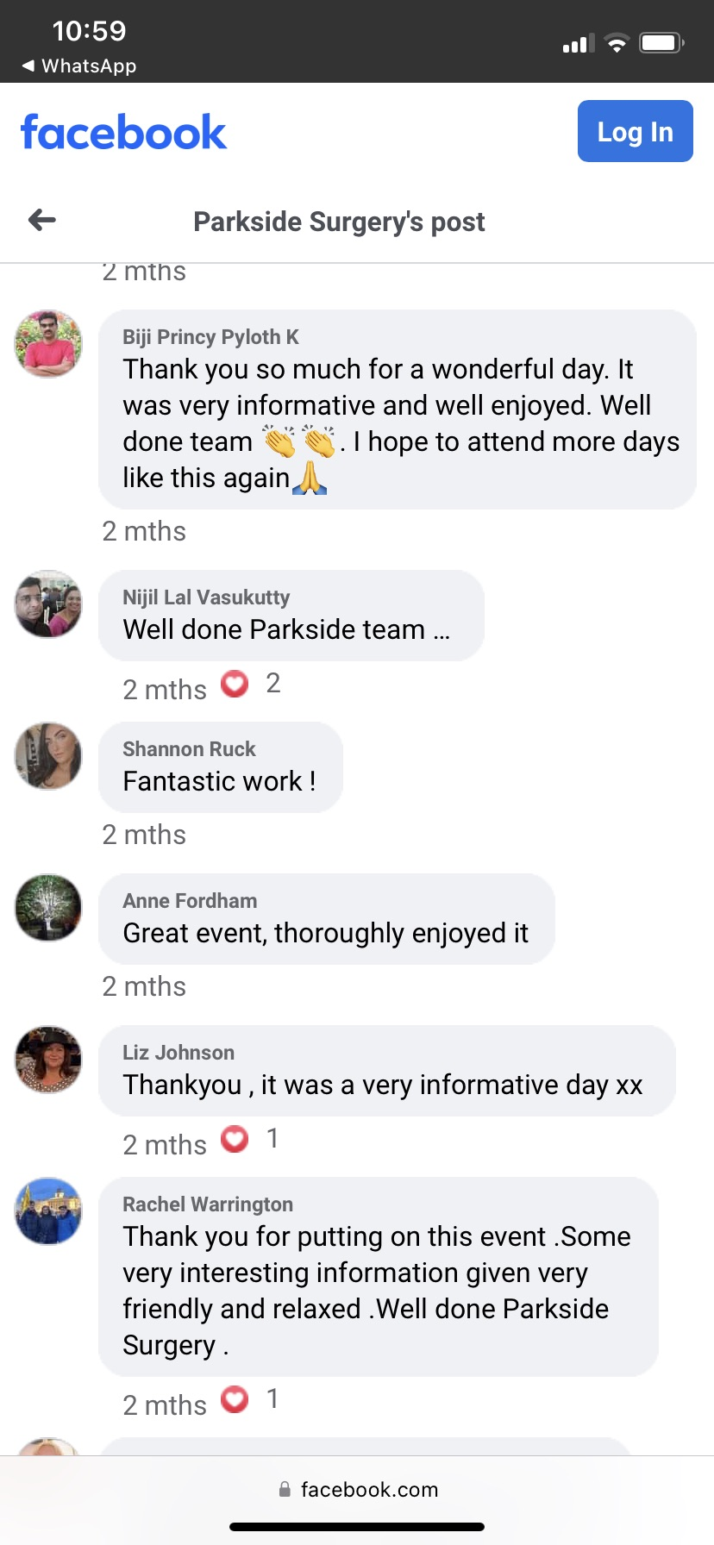
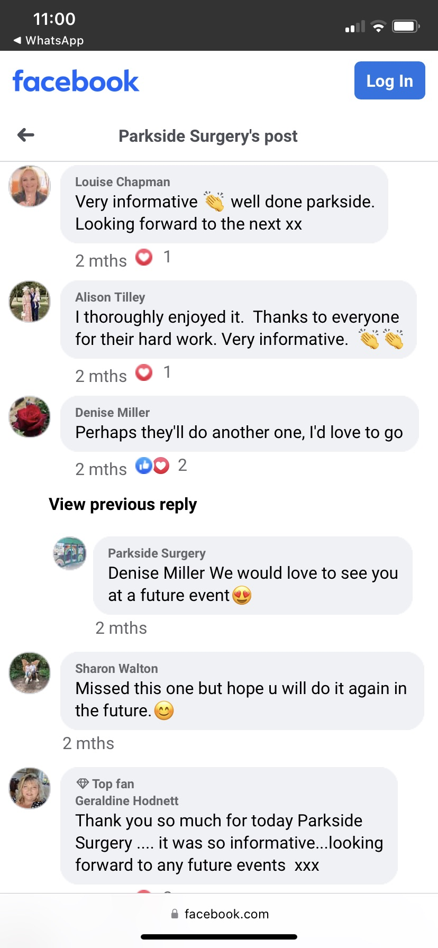

Slide 47

Outcome –More Events to come …
PCN expressed interest in organising and funding Men’s Health Event and wishes to continue with Women’s Health Event
Event planned for late summer in Boston Football Stadium.

Slide 48
GP Leader – Expectations
Envisioning the future
Setting Strategic Direction
Analysing Data
Considering options for deploying resources
Developing ourselves and Others
Maintaining our health and well being
Leadership: 2. Leadership - understanding yourself | RCGP Learning

Slide 49

Personal Development

Slide 50

Senior GP Leadership Programme
4- day course in November 2023
Strategic planning
Coaching and mentoring
Finance
Leadership styles

Slide 51
Strategy : Understood Strategic planning better
Finance : Improved basic knowledge and understanding of practice finance better
Cashflow
Budgeting
Leadership Styles :Overview of different models and self -assessment
Coaching and Mentoring : Understand the difference between coaching and Mentoring
Governance and Risk Management

Slide 52
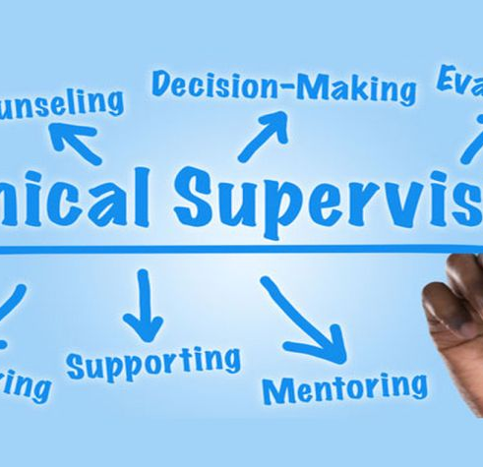
Clinical Supervision To ACP Trainee
Monthly Mentor Meetings
On Site Supervision
Work Based Assessment

Slide 53

NB Medical
RCGP Podcast
Talking General Practice
The General Practice Podcast
Primary Care Knowledge Boost
BMJ Best Practice

Slide 54
RCGP Leadership E-Learning -
An Overview of GP Leadership
What organisation is strength and challenges ?
Understand the skills of working in and leading a team
Appreciate value of other people’s contribution
Be able to participate in and chair effective meetings
Reflected on Leadership Styles

Slide 55
My Leadership Style
Compassionate and Inclusive
Transformational

Slide 56
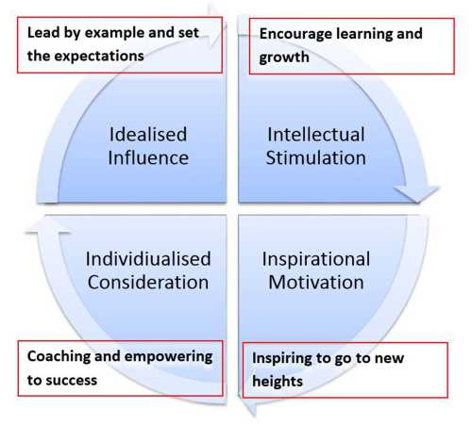
My Leadership styles
Transformational Leader

Slide 57

Challenges
Personal
Lack of engagement
Time constraints

Slide 58

Thank You

